Slide 1
Managing your time
Now you know the areas you are less good at – how can you improve?

Slide 2
Not good at prioritising?
Make a TDL!
Beside each item give it a rating (from 1-5) of how important it is and how long it will take
Show to someone else and see if they agree

Slide 3
TDL
Doing research for assignment 1 2hrs
Completing basic skills exam 1 1hr
Seeing tutor to ask for help 2 30 mins
Doing extra reading for class 4 1hr
Meeting friends for coffee 3 3hrs

Slide 4
SMART objectives
SMART
Specific
Measurable
Achievable
Realistic/Relevant
Time-related

Slide 5
Always procrastinating?
Ask yourself why you are putting something off.
Is there another reason behind any excuses?
“I don’t really understand the topic.”
“I haven’t thought about how I will structure it.”
“I’m worried I’m going to fail so I’m not going to try.”
What action can you take to combat these underlying reasons?

Slide 6
Solutions?
Don’t know where to start? Try making a list or brainstorming tasks.
Stay away from other procrastinators! Try to work with energetic go-getters!
Work back from deadlines. Break an assignment into smaller chunks setting yourself ‘mini-deadlines’.

Slide 7
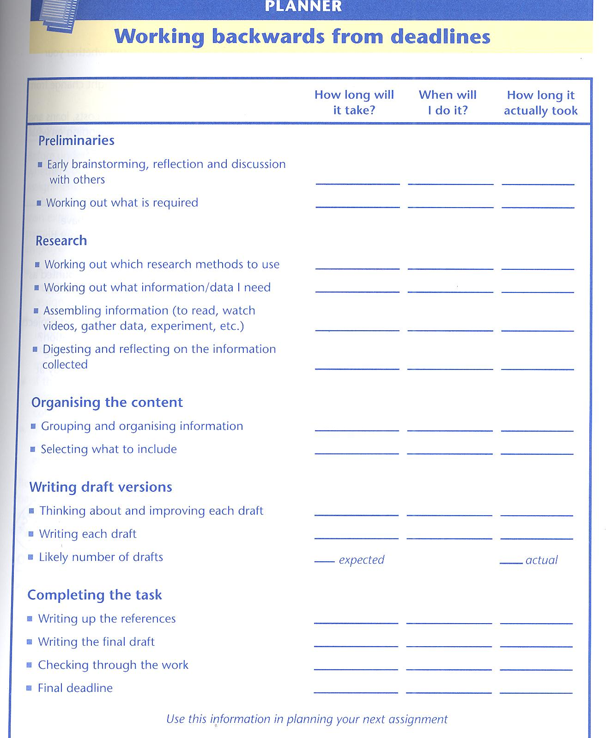

Slide 8
Are you self aware?
Knowing the people and places that distract you
Being assertive
Being realistic about what you can achieve in a certain time
Are you an early morning person or night owl?
Switching off your mobile and social networking!

Slide 9
Do you plan effectively?
Paper diary/electronic diaries/calendars
Breaking down big tasks into smaller chunks or combining activities. Include study and relaxation
10 minutes study
10 minutes walking around
20 minutes study
20 minutes having cup of tea
10 minutes study

Slide 10
Busy, busy, busy!
Maximise the time you have available in the day. Use time spent on trains, in queues etc. to run through revision notes, plan assignments, reflect on class notes.
Carry a notebook with you to jot down essay ideas.
Invest some time improving your notetaking and reading techniques to save time in the long run.

Slide 11
Busy, busy, busy!
Organise notes and remember to write down bibliographical details of sources as you go.
Try to combine areas of your life – if you are working, can you use a real life project as part of an assignment?
Find a study space where you can concentrate on academic work without interruptions from colleagues, family or kids.

Slide 12
Reviewing!
Flexibility – keep updating your TDL and planning
Assess whether a technique has worked and whether you can change it in the future

Slide 13
Do you need to be in control?
Recognise when you need help
Trust other people’s abilities
Communication and organisation in group work

Slide 14
Perfectionist?
Don’t be afraid to make mistakes – part of the learning process.
Don’t compare yourself to others – look for steady improvement.

Slide 15
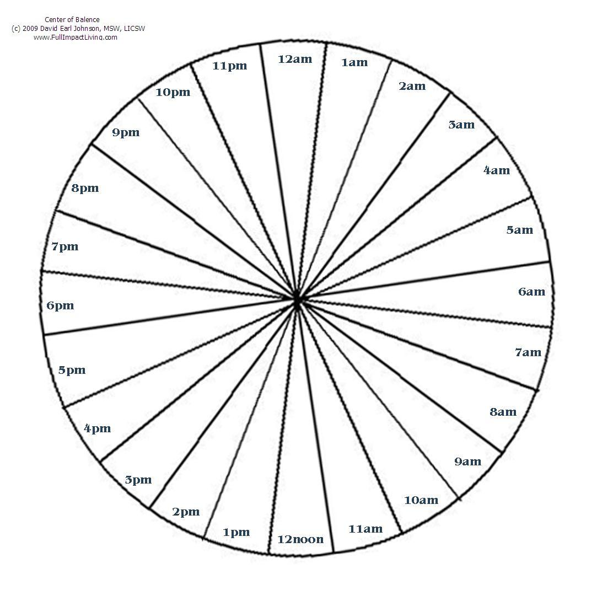
Time Circle
Cottrell, S. (2008) The study skills handbook. 3rd ed. Basingstoke: Palgrave Macmillan.

