Slide 1

Essay Writing

Slide 2
I want top marks!
Interpretation
Research
Planning
Writing
Revision

Slide 3
Interpretation
Advertisers seek only to ensure money is made for the clients they represent. Do you agree?

Slide 4
Interpretation
Advertisers seek to ensure money is made for the clients they represent. Do you agree?
Advertisers seek only to ensure money is made for the clients they represent. Do you agree?

Slide 5
Explain
Describe
Define
Evaluate
Create
Notes:
ACTIVITY – In groups, ask the students to discuss what each of these instruction words mean in terms of essay questions. Also, can they put them in an order relating to how much depth you would need to go into in your answer if faced with a question containing these terms.

Slide 6
Define
Describe
Explain
Create
Evaluate
Notes:
Order is based on Bloom’s Taxonomy which demonstrates depth of learning based on what you can do with your knowledge of a particular concept. See next slide for more examples.

Slide 7
Knowledge
Knowing a fact; being able to recall
or recognise it
Comprehension
Understanding what a fact means
Application
Being able to put a fact to use; applying knowledge in practice
Analysis
Able to break information into parts; identify relationships/cause and effect
Synthesis
Extract relevant facts from a body of knowledge – use these to address an issue in a new way
Evaluation
Arrive at a judgement based on knowledge
State, List , Label, Recall, Define, Identify
Describe, Categorise, Classify, Associate, Interpret
Demonstrate, Apply, Use, Solve, Calculate
Compare, Discuss, Give reasons, Explain
Compose, Construct, Design, Combine, Integrate
Support, Judge, Decide, Appraise, Recommend
Notes:
Bloom’s Taxonomy on left and essay question words that relate to it on right.
Discuss with students the concept of ‘going into enough depth’. If an essay question asks them to ‘identify and evaluate’, the higher level skill is the evaluation, so it would follow that more effort should be put into this.
Analysis and evaluation would comprise what we call ‘critical writing’.

Slide 8
Planning
Brainstorm
Research - Select
Plan conclusion
Plan sections/paragraphs

Slide 9
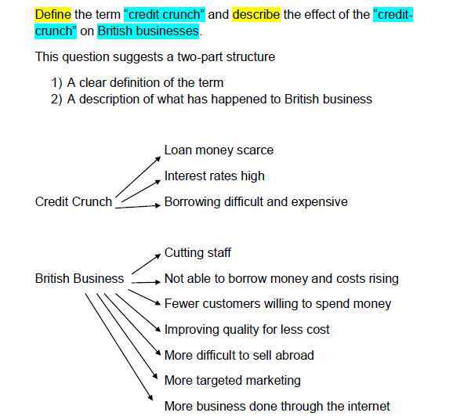
Notes:
A student interprets their essay question

Slide 10
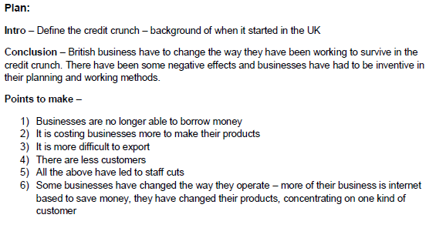
Notes:
Simple plan based on this question

Slide 11
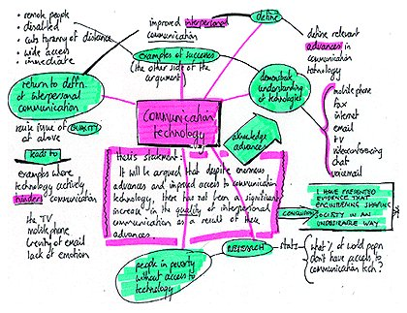
Notes:
A different way to plan, depending on how your brain works!!

Slide 12
Essay Structure
Beginning
Body
Conclusion

Slide 13
Essay Structure
Introduction
Main points that will be covered and why these are important
Brief account of current thinking/opinion
Defining terms
Making your position clear from
outset
Notes:
Compare essays to reports. Reports lay out a lot of information in a preliminary literature review or findings section, whereas essays introduce evidence and information as and when it is relevant in the main body of the text. Essay introductions should be pretty brief.

Slide 14
Essay Structure
Body
Avoiding too much description unless specifically requested in essay question
Presenting a case or argument, comparing viewpoints
Providing evidence and
judgements/evaluation

Slide 15
Essay Structure
Body
Consider the flow and order – group similar points together
Signposting phrases to link paragraphs and sections
Be selective – cover most
important points and select
most compelling evidence
Notes:
Flow/Order will relate back to your planning stage. The planning stage will allow you to decide what it the most logical order to present information in order to lead your reader to the desired conclusion.
Might not be possible to include all your ideas and all the evidence you have collected, so decide on the most important points and also on the evidence which best illustrates your ideas – don’t need 10 bits of evidence to demonstrate one idea.
ACTIVITY – In groups, ask students to think of linking words/phrases to express the following ideas 1) Beginning/introducing an idea/line of thinking 2) Adding similar reasons or information 3) Adding conflicting ideas/reasons 4) Introducing a conclusion
e.g. 1 Initially, First, Firstly, From the outset, In the first instance, To commence
2 Additionally, similarly, in agreement with, likewise, in the same way,
stronger words to add more reasons = furthermore, moreover, what is more, indeed
3 However, conversely, contradicted by, alternatively
4 Therefore, it can be said that, In conclusion, It can be demonstrated that, This suggests, This implies

Slide 16
Essay Structure
Balance
Presentation of evidence, facts, findings
Analysis and conclusions

Slide 17
Essay Structure
Conclusion
No surprises here!
Drawing together of all the points made to create an overarching conclusion
Relate conclusion back to essay title

Slide 18
Introduction
Main discussion
Conclusion
Outline idea
Discussion of idea
Draw a conclusion
Notes:
Now looking in more detail at paragraph structure and how this mirrors the overall essay structure.

Slide 19
Outline a topic or point of view
Present facts relating to the topic with evidence to support
Explain the significance of the evidence and any conclusion that can be drawn from it
Notes:
More detailed explanation of paragraph structure

Slide 20
Many organisations report that skills shortages can be observed in both applicants and current staff, with employers estimating that 25% of their vacancies are in areas where they believe there is a skills gap. Additionally 16% of organisations surveyed believed there was a skills gap amongst current staff (Learning and Skills Council, 2006). These figures could suggest an increased importance in the training element of Human Resources will be seen in the future. Companies may consider training staff to increase productivity in their current role, but also with a view to filling higher level roles where the external labour market cannot supply suitable candidates.
Notes:
Example following model on previous slide

Slide 21
Outline a topic or point of view
Give reasons for agreeing or not agreeing with the topic
Give evidence to back up point of view
Explain how evidence supports view
Discuss any conflicting points of view
Draw a conclusion – is the view supported? Any ‘buts’?
Outline two points of view
Give reasons for and against each
Give evidence to back up each point of view
Explain how evidence supports each view
Make a decision – what point of view do you support?
Explain why you support this point of view? Any ‘buts’?
Agreeing/Disagreeing with a point of view or theory
Comparing two points of view
Notes:
Two slightly more sophisticated structures for paragraphs

Slide 22
Convincing your reader
Notes:
ACTIVITY – Students look at the ‘Convincing your reader’ handout and discuss positive and negative elements of both in terms of selection of evidence, relevance to question, analytical skills etc. NOTE: although one example is more obviously ‘bad’, there are still negative issues to be noted with the second example (although it is a bit better than the other one)!!

Slide 23
Convincing your reader – final tips
All statements backed up with evidence from primary or secondary research
One idea discussed per paragraph
Logical progression of ideas- links between paragraphs/ideas
Make clear links back to the question, and to the main point you are making
Balanced argument
Keep sentences brief and to the
point and language straightforward

