Slide 1
Logs and Blogs

Slide 2
What is a reflective log?
A record of your learning experiences, thoughts, feelings and reflections
Not just a diary of what you have done – but a critical assessment of how you have progressed
Less formal than other kinds of assignments

Slide 3
To be reflective you need to ask yourself some questions:
What have I achieved, how has this helped me work towards my objectives?
Have I made progress?
Have I developed new skills?
How might I use these skills in the future (at university or in the workplace)?
How have I changed my learning style?
What would happen if I continued to practice this new skill?

Slide 4
Think about the last assignment you did....
Were you satisfied with the result?
How could you improve your marks?
What new things did you try?
How did you overcome any difficulties?

Slide 5





Ask Auntie Deidre...

Slide 6
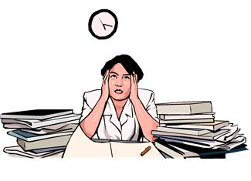
Dear Auntie Deidre,
I didn’t get a very good mark for my assignment and I’m really upset. My essay was better than other people’s but my tutor said it didn’t answer the question.
Please help, Anna

Slide 7

Dear Auntie Deidre,
I think I am someone who learns best when I write lots of lists. I wrote all the information from class in a long list but I still didn’t do very well. What can I try next time?
Dino

Slide 8

Dear Auntie Deidre,
I got a merit in my assignment again! I work really hard and spend ages on the assignments but how can I get a distinction?
What can I do, Muna

Slide 9
The benefits of logs
What skills do you think you develop by writing a log?
Students who write logs in a reflective way tend to become:
Analytical, questioning, self aware, skilled communicators, tolerant, diplomatic

Slide 10
Blogs
Online journal/diary where posts are arranged chronologically
Wikis
Group of web pages that lets users add and edit content. Posts are organised by theme

Slide 11
What is Web 2.0?

Slide 12

Facebook
Twitter
Discussion boards

Slide 13
For a group blog/wiki on Moodle what do you think the rules should be?
Acknowledge when someone else has made a good point
Be positive in your criticism of others
Be truthful
Acknowledge if you have got information from somewhere else (plagiarism still applies)
Be brief, to the point and logical
Follow the instructions for the assignment
Try not to get too emotional or upset about comments from other people

Slide 14

Bad netiquette and what to do about it
Shouting
Flaming
Trolling
scrolling

Slide 15
What does your digital identity say about you?
What happens when you Google yourself?
How do you decide what information to put on Facebook?
What does your email address say about you?

