Slide 1


Exam Today!
Notes:
Ask students what they worry about when it comes to exams

Slide 2

Revision Tips

Slide 3
Active Revision
  Making notes from texts & further reading
  Mind maps/visual aids
  Working through problems/examples/ sample questions
  Making up your own exam paper and swapping with a classmate
  Testing each other

Slide 4
Brainstorming
  Brainstorm topics and information
  Make connections
  Use abbreviations, symbols, drawings, colours
  Quotes and / or theories

Slide 5
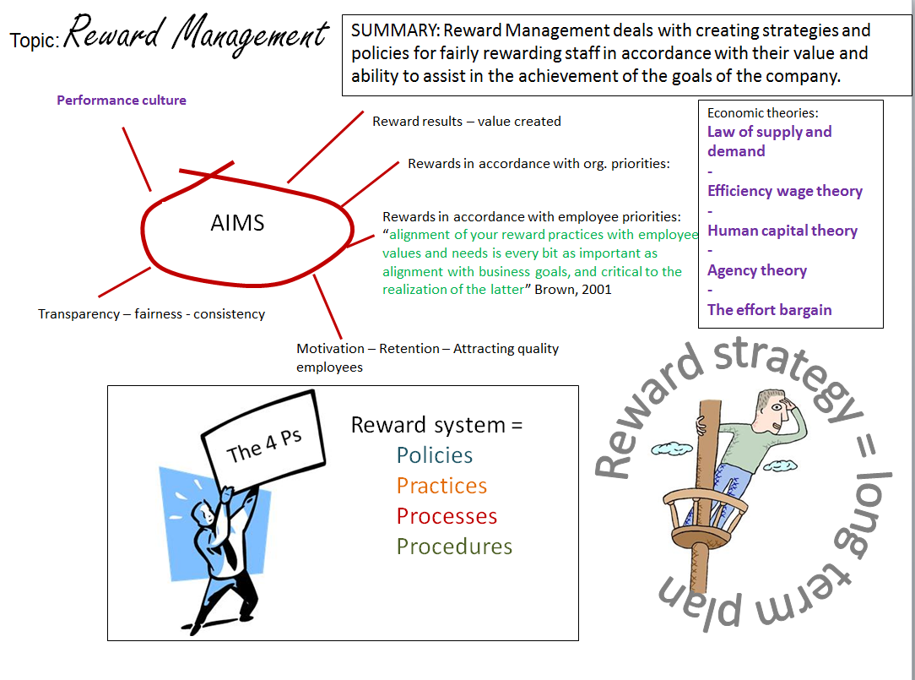

Slide 6

I have a
Terrible
memory

Slide 7
Exams aren't a memory test
  To assess your understanding, ability to apply what you have learned and your analytical/critical skills
  However, some facts/figures/key terms/formulas etc. may need to be learned off by heart
You won’t see a question that says “Write everything you know about...”

Slide 8
Tips for remembering
key facts
  Reciting information to yourself
  Revision cards
  Memory journey
  Mnemonics

Slide 9
Other Preparations
  Research the exam structure
  Read the marking criteria
  Ask tutor for as much information as possible
  Try to find old exam papers

Slide 10
Exam Strategy
Each strategy has its own advantages and disadvantages you need to find the one that works best for you
Answering the most difficult question first
Answering the short fact-based questions first
Planning each answer before you start writing
Leaving any question you don’t understand until last

Slide 11
Short Questions
What type of answers will be needed in a ‘short questions’ exam?
Listable items
Definitions
Providing examples to illustrate an idea
Main aspects of a theory – why a theory is significant
Recognising a quote or idea – explaining its significance
Describing a process or procedure
Listing similarities/differences – advantages/disadvantages
Demonstrating the use of a formula
Notes:
So if you have a 5 mark question you should try to make 5 points
Like with essay make sure you are clear if the question has more than one part – if its two parts answer both
Make sure you are aware of key terms in your field and use them
The more marks your question has the more time you should spend on it, so don't waste time on questions with just a few marks
Try and answer all the questions even if you don't know the answer, you might find that part of your attempt was right and gain an extra mark or 2

Slide 12
Short Questions
Number of marks suggests how many points you need to make
Don’t spend too much time on questions only worth a few marks
Use key phrases/terms
Two part questions
If you don’t know something don’t worry – guess!
Notes:
So if you have a 5 mark question you should try to make 5 points
Like with essay make sure you are clear if the question has more than one part – if its two parts answer both
Make sure you are aware of key terms in your field and use them
The more marks your question has the more time you should spend on it, so don't waste time on questions with just a few marks
Try and answer all the questions even if you don't know the answer, you might find that part of your attempt was right and gain an extra mark or 2

Slide 13


