Slide 1
Plagiarism and
Referencing

Slide 2

What is plagiarism?
Including:
Another person’s actual words (written and spoken)
Another person’s ideas or theories
Facts/statistics that are not common knowledge
Presenting someone else’s work as your own.

Slide 3
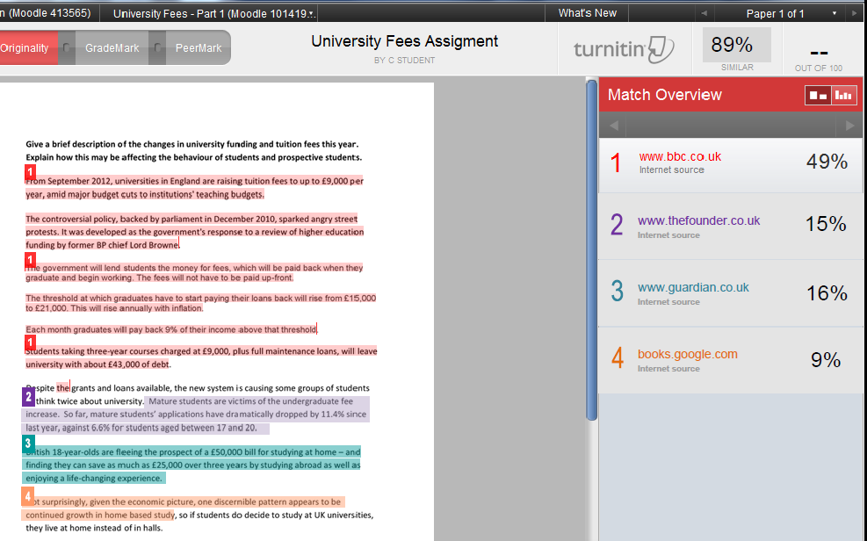

Slide 4
When do you use quotes and references?

Slide 5
Quotations and Bibliographies
Quoting
Including passages or ideas from books and articles within your assignment
Writing a bibliography
  Writing a list of all the books and
  articles you have used

Slide 6
Direct quotations
Direct copying of a section from a book, journal article, website etc.

Slide 7
  Human resource planning is an important part of business planning. “Plans are normally divided into short, medium and long terms. The period over which business plans extend varies from one organisation to another” (Currie, 2006, p.59).

Slide 8
Indirect quotations
Reference to an idea credited to an author
Putting an author’s ideas into your own words

Slide 9
  Teaching assistants may be involved in helping and monitoring volunteers. An important part of this will involve the induction of volunteers and providing them with all the information they need (Kamen, 2008, p.150).

Slide 10
  The famous Mayan site in Chichén Itzá is described as being one of the main attractions of Mexico and worth an even longer visit (Kohnstamm, 2004).

Slide 11
Websites?

Slide 12
Like many large companies, Ikea has a programme of social initiatives, for instance this year “it will spend about $163m on grassroots development programs in India alone, and has been working with agencies like the United Nations Development Programme and Unicef” (Dutt, 2010).

Slide 13
What do you include in a bibliography?
Armstrong, D. (1996) From Versailles to Maastricht. Basingstoke: MacMillan.

Slide 14
How to create a bibliography
Browning, G. (2003) Grass roots management. Harlow: Pearson Education.
Grewal, D. and Levy, M. (2012) Marketing. 3rd ed. New York: McGraw Hill.
McVeigh, K. (2011) Disabled marchers turn out in thousands for benefits protest. Available from: http://www.guardian.co.uk/society/2011/may/11/disabled-marchers-thousands-benefits-protest (accessed 1 Sept. 2012).

Slide 15
Problems?

Slide 16
Multiple authors
Up to 3 authors, write all three in the in-text reference
More than 3 authors, write the first then et al.
“The green slime discovered on the surface of Mars confirmed the existence of alien life forms” (Richards, Smith and Lydiard, 2011, p.4).
“The green slime discovered on the surface of Mars confirmed the existence of alien life forms”(Richards et al., 2011, p.4).
In the bibliography, write all authors – even if there are lots!
Richards, A., Smith, D., Lydiard, T. and Roberts, R.

Slide 17
Authors citing other authors?
If you are reading a book by Renee Anderson who quotes another work by Chris Baker – what do you do?
In text:
(Baker , 2000, cited in Anderson, 2010, p.45)
Bibliography:
Just include the ‘Anderson’ book

Slide 18
Emails, letters, unpublished interviews?
Sender/speaker (year) Medium and receiver of communication, day/month.
Fry, S. (2010) Letter to Alan Davies, 27 September.

Slide 19
Online journal databases?
Martindale, N. (2009) ‘The pros and cons of online assessment’, Personnel Today, 20 October, pp.12-13.
Martindale, N. (2009) ‘The pros and cons of online assessment’, Personnel Today, 20 October, pp.12-13, General OneFile [online]. Available at: http://go.galegroup.com/ps/
i.do?id=GALE%7CA210242645&v=2.1&u=west&it=r&p=GPS&sw=w (accessed 5/10/12).

