Slide 1

Google-d Out!
Where do I start?

Slide 2
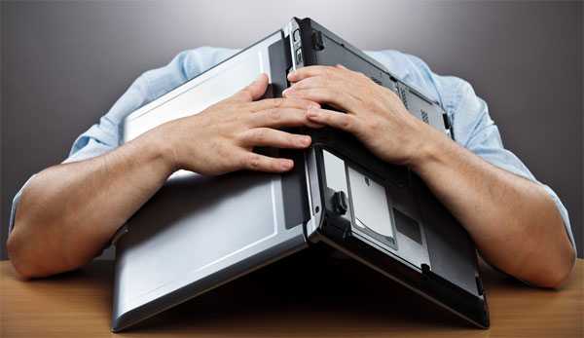
Search problems
Notes:
what problems do you find with search engines?

Slide 3
Search problems
Too many results
Results not relevant enough
The sources are not reliable
Too old
Notes:
Common problems

Slide 4
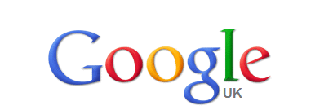
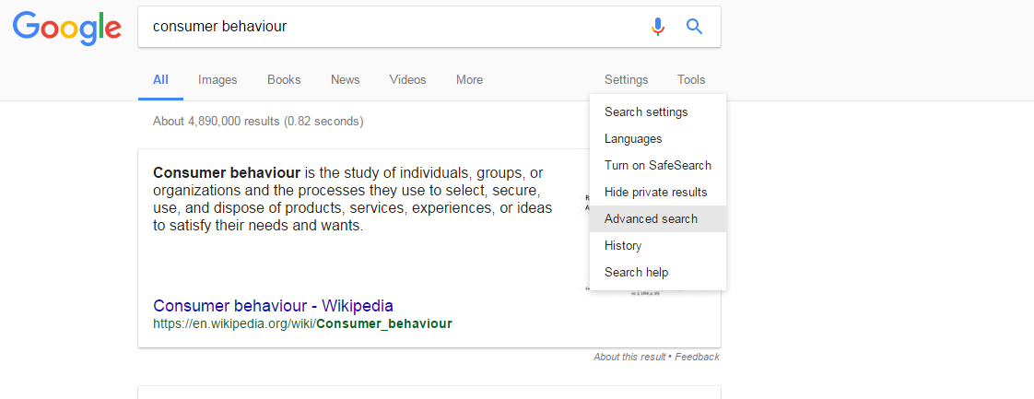
What are your tips?
Notes:
What tips do you have?
Try and Advanced search on Google
On the Advanced search you can do things like choose a region, how up to date you want it, type in a specific domain like .gov.uk, choose a file format like a pdf…. These can help you narrow your results down and make them more relevant, and sometimes more reliable.

Slide 5
What to search for?
Keywords – Brainstorm/Mind Map
Specialist terms
Synonyms/Alternate spelling
Notes:
What do you search for? Searching the whole assignment title wont get the results you need. You should use the keywords and if you need better results think of other ways you can say the same thing (just make sure you don’t sway from the topic).

Slide 6
What to search for?
What are the key words in the assignment title below?
Assignment.
Investigate the rise in popularity of the gastropub since the early 1990s. How has this influenced the restaurant industry?

Slide 7
What to search for?
These are…
Assignment.
Investigate the rise in popularity of the gastropub since the early 1990s. How has this influenced the restaurant industry?

Slide 8
What to search for?
Investigate the rise in popularity of the gastropub since the early 1990s. How has this influenced the restaurant industry?
“rise in popularity”
development
since the 90s/1990s
recently/recent
“restaurant industry”
“food service industry”
gastropub
“pub dining room”
Notes:
Different ways you can search those terms

Slide 9
Which sources should I use?
RELEVANCE
Is the source up-to-date?
Does the source give me specific information on the topic I am researching?
Is the source of a high enough level?
Notes:
Things to check to make sure your source is relevant

Slide 10
Which sources should I use?
RELIABILITY
Fact or opinion?
Sufficient evidence to back up opinions?
Produced by an expert in the field/reliable organisation?
Are the methods used to collect data appropriate?
What am I being asked to think or believe – I am convinced by the argument?
Notes:
Things to check to make sure your source is reliable

Slide 11
If you were looking for information on Customer Service would the following website be good or bad to use?

Slide 12
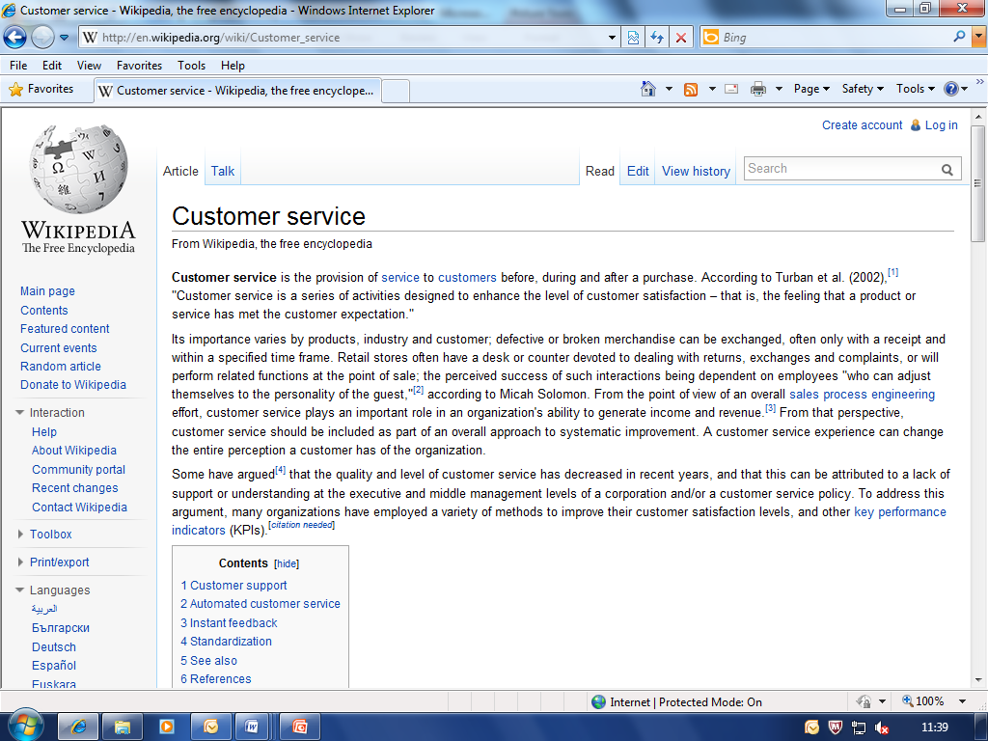

Slide 13
Bad
Wikipedia is not a reliable source as anyone can edit the information – you lose marks for using this website

Slide 14
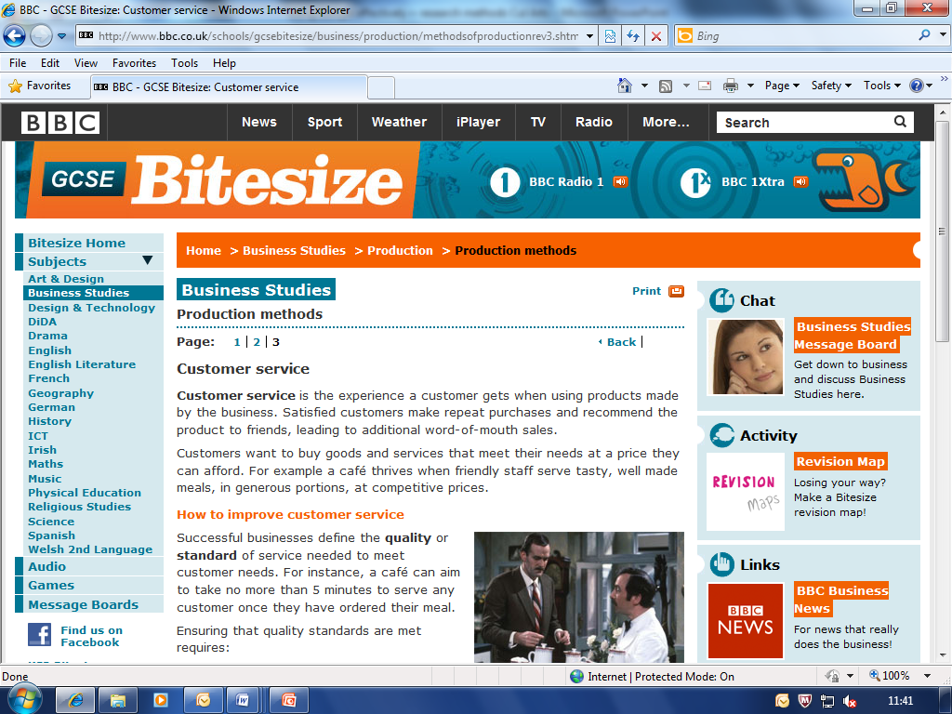

Slide 15
BBC is a reliable source of information so this website is not bad. However as it is targeted to GCSE students it isn’t suitable for your course work.

Slide 16
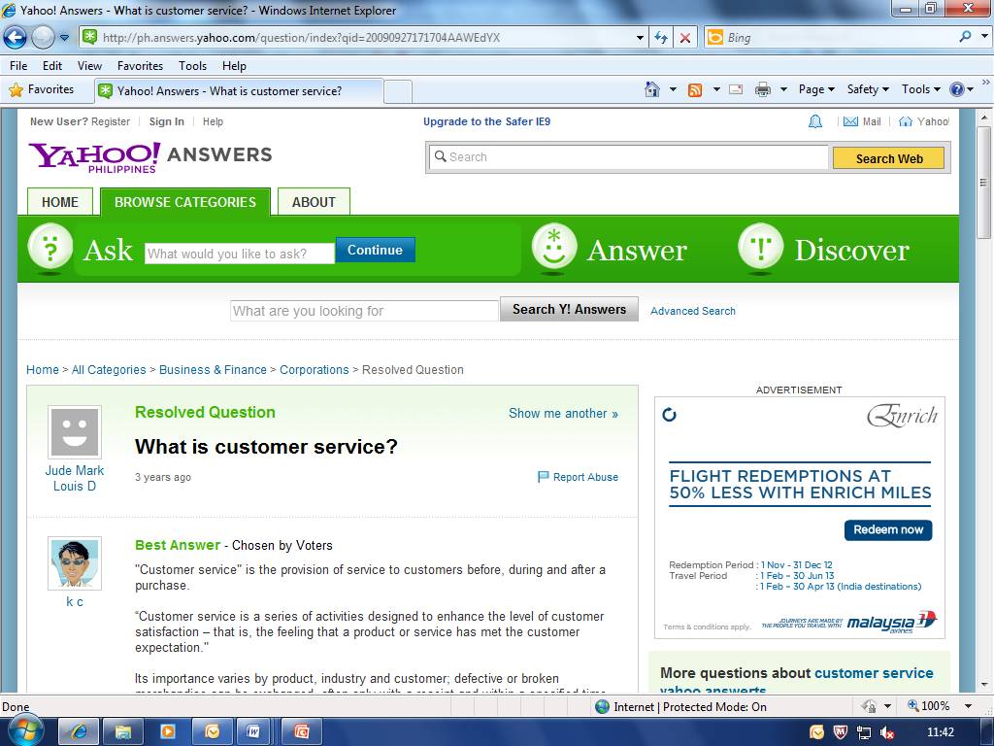

Slide 17
Bad
Blogs are peoples opinions, and the people posting comments are not necessarily professionals in the area of discussion, so you can’t use this information.

Slide 18
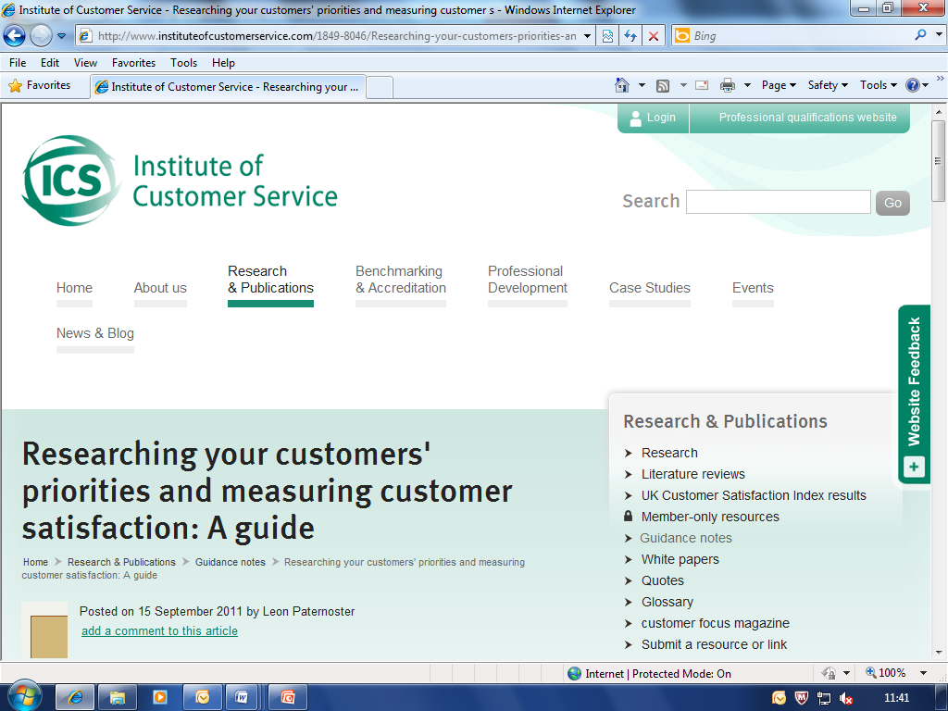

Slide 19
Good
This is a legitimate organisation so the information has to be reliable. The only issue might be the date, as it was published in 2011. So it might be too old, you have to judge how up-to-date you need your information to be.

Slide 20

Other Resources
Learning Centre online resources on…
Click here
Go to the Learning Centre pages (scroll down to the bottom and click ‘Learning Resources’)
Click ‘e-resources’ on the links at the top of the page
View e-resources
Notes:
Click Moodle

Slide 21
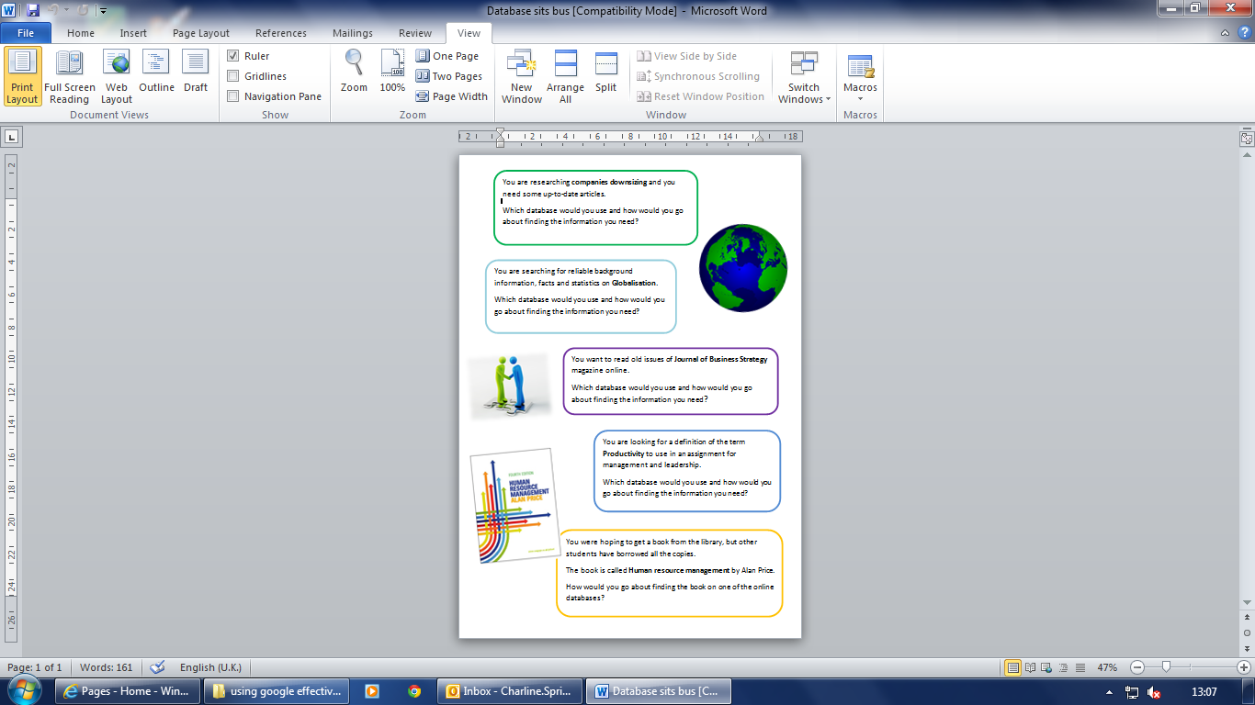
Activity
Use the following databases to find the information for these scenarios;
Credo
Ebrary
Myilibrary
Ebsco
Issues Online

Slide 22
Quiz
Notes:
Click the circle to go to moodle, to show them where the quiz is (link for quiz is at the bottom of the main Victoria resources page)

