Slide 1

Managing your time
Now you know the areas you are less good at – how can you improve?

Slide 2
Not good at prioritising?
Make a TDL!
Beside each item give it a rating (from 1-5) of how important it is and how long it will take
Show to someone else and see if they agree

Slide 3
TDL
Doing research for assignment 1 2hrs
Completing basic skills exam 1 1hr
Seeing tutor to ask for help 2 30 mins
Doing extra reading for class 4 1hr
Meeting friends for coffee 3 3hrs

Slide 4
Always procrastinating?
Be self aware and ask yourself why
You will always be able to find an excuse
Is the excuse your giving yourself the real reason?
“I can’t do my essay because I haven’t read any books”

Slide 5
The real reason...
“I don’t really understand the topic.”
“I haven’t thought about how I will structure it.”
“I’m worried I’m going to fail so I’m not going to try.”
Never put something off when it could be done straight away! You’ll spend less time worrying.

Slide 6
Are you self aware?
Knowing the people and places that distract you
Switching off your mobile and social networking!
Being assertive
Being realistic about what you can achieve in a certain time
Are you an early morning person or night owl?
Are you a perfectionist? You need to know when enough is enough!

Slide 7

Do you plan effectively?
Weekly versus daily planning
Paper diary/electronic diaries/calendars
Breaking down big tasks into smaller chunks or combining activities. Include study and relaxation
10 minutes study
10 minutes walking around
20 minutes study
20 minutes having cup of tea
10 minutes study

Slide 8
Reviewing!
Be flexible to change your plan
Don’t get despondent if things don’t work out
Be positive
Assess whether a technique has worked and whether you can change it in the future

Slide 9

Do you need to be in control?
Recognise when you need help
Trust other people’s abilities
Communication and organisation in group work

Slide 10
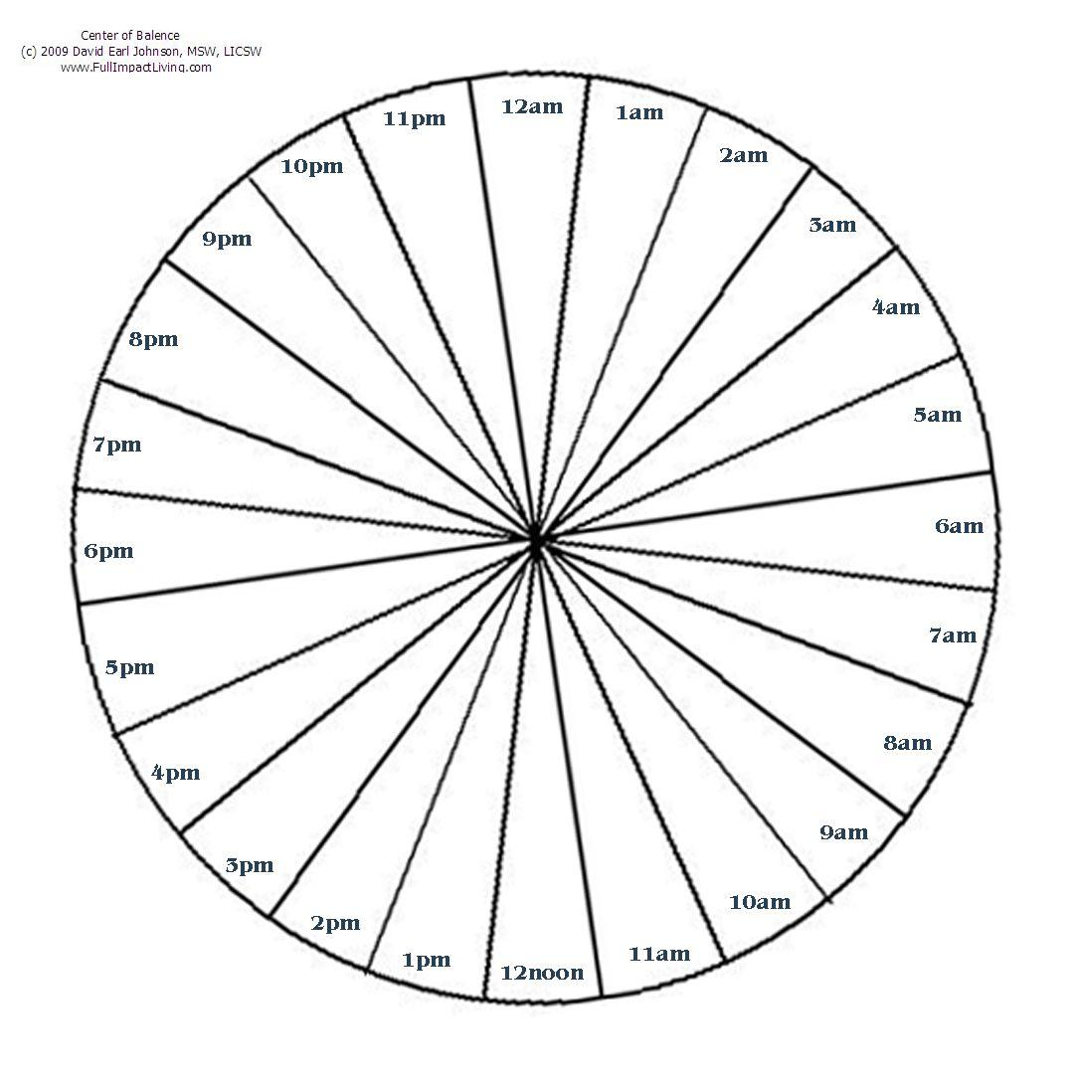
Time Circle
Cottrell, S. (2008) The study skills handbook. 3rd ed. Basingstoke: Palgrave Macmillan.

